Slide 1





CUSTOMER RETENTION Presentation “E-retail factors for customer activation and retention: A case study from Indian e-commerce customers”
Prepared by: Maahi Gurnani, Data Science Intern at Flip Robo Technologies

Slide 2
INTRODUCTION
Customer satisfaction has emerged as one of the most important factors that guarantee the success of online store; it has been posited as a key stimulant of purchase, repurchase intentions and customer loyalty.
A comprehensive review of the literature, theories and models have been carried out to propose the models for customer activation and customer retention.
Five major factors that contributed to the success of an e-commerce store have been identified as: service quality, system quality, information quality, trust and net benefit.
The combination of both utilitarian value and hedonistic along with Perceived Risk values are needed to affect the repeat purchase intention (loyalty) positively.

Slide 3
What IS customer Retention and Its Importance
Customer retention refers to company’s ability to turn customers into repeat buyers and prevent them from switching to a competitor.
BENEFITS:
Retention is cheaper than acquisition :Acquiring a new customer can be up to five times more expensive than retaining an existing one.
Loyal customers are more profitable :An increase in client retention by 5% can enhance profits by over 25% .
You’ll earn more word-of-mouth referrals :The longer customers stay with a company, the more business, positive reviews, and they bring word of mouth advertising.
Engaged Customers Provide More Feedback: Over 37% of customers will only post online reviews if they are “extremely satisfied”
Loyal Customers are more forgiving

Slide 4
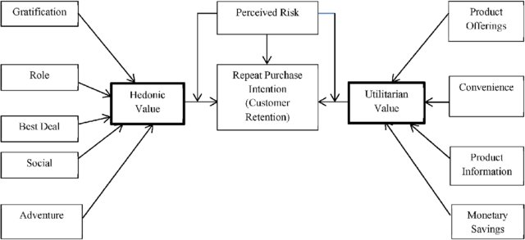
Figure: Customer Retention factors
The customer retention is based on three main factor Hedonic value, Perceived Risk, Utilitarian

Slide 5
Tips for succeeding Customer Retention
Find out what customers want & what causes them to stay or leave ?
Proactively collect and promote customer feedback.
Analyze customer feedback to gain valuable insights and ensure the right people hear it.
Take action and Measure the results
Actively measure and monitor your customers’ loyalty and engagement
Keep asking, listening analyzing and improving

Slide 6
Problem Statement
The data is collected from the Indian online shoppers of most popular websites: Amazon, Flipkart, Paytm, Myntra and Snapdeal. The Results indicate the e-retail success factors, which are very much critical for customer satisfaction
Scope
The scope of this analysis lies in evaluating what practices are been liked by the customers and where there is scope of improvement. And thus helping in retaining and maintain their customer base.
Ideology
Lifetime revenue is the end goal, not just today’s revenue

Slide 7
Dataset Description
The dataset contains combination of both utilitarian value and hedonistic values, which both are needed to affect the repeat purchase intention of the customers
The dataset contains the details of all the customers who shop online frequently and their experience of buying products. From these details we need to find the success rate of online retailers.
The dataset columns question are having three categories
1.General Questions (column1- column 17)
2.Where Ratings are involved (column 18- column 47)
3. Voting of Application/Website preference (After 47)
The column titled : 'Which of the Indian online retailer would you recommend to a friend?' represents a customer’s loyalty to a website and therefore, its customer retention

Slide 8
Exploratory Data Analysis(EDA):
Exploratory Data Analysis, or EDA is the process of investigating the dataset to discover patterns, and anomalies (outliers), and form hypotheses based on our understanding of the dataset.
Various Libraries imported to start working on Jupyter Notebook are as follows:
• import numpy as np
• import pandas as pd
• import seaborn as sns
• import matplotlib.pyplot as plt

Slide 9
df_cust_ret.shape
The size of the dataset is 269Rows * 71Columns
df_cust_ret.dtypes
: Except for Pin Code column which is continuous types, all other have categorical data
df_cust_ret.isnull().sum()
Saw no missing data was present in columns
for i in df_cust_ret.columns :print(df_cust_ret[i].value_counts())
Used for checking the value counts of unique elements of each columns

Slide 10
Dividing the Data Frame into respective category of columns
General Questions (1-17)
Where Ratings are involved (18-47)
Voting of Application/Website preference (After 47)

Slide 11
Data Visualization
Univariate Analysis-The analysis was done based on the 3 column categories mentioned above.
General Questions(1-17)
Where Ratings are involved(18-47)
Voting of Application/Website preference(After 47)

Slide 12
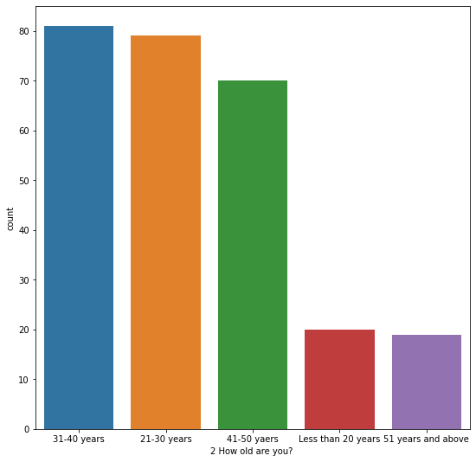
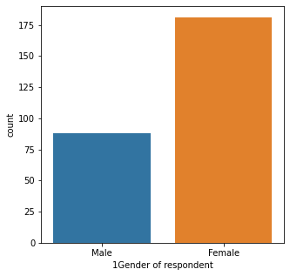
Various Plots for Category 1:General Questions

Slide 13
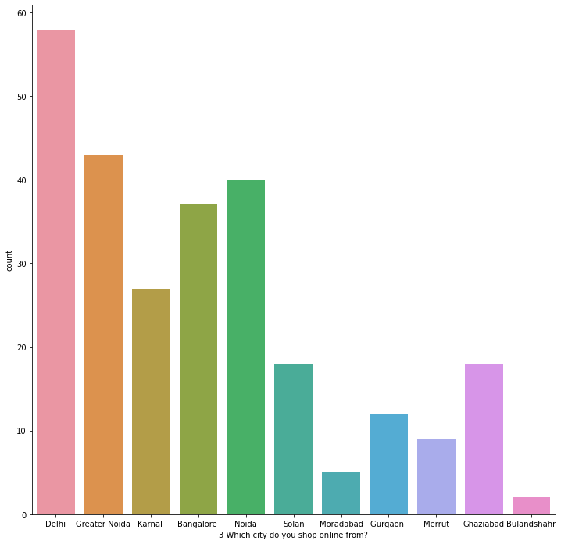

Slide 14
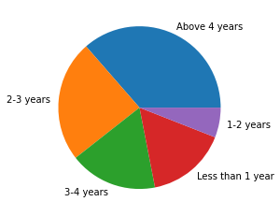
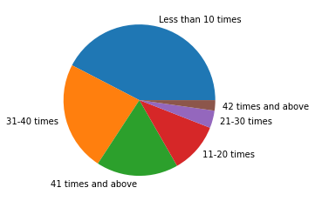
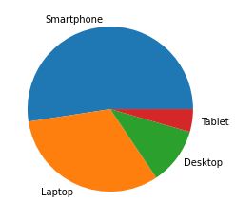
How many times you have shopped in last 1 year
From how long are you shopping
Which device do you use for shopping

Slide 15
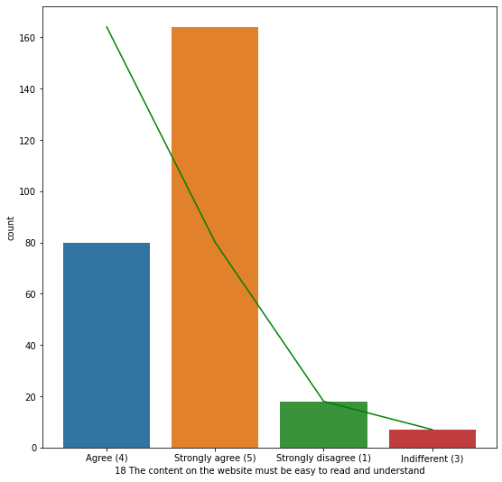
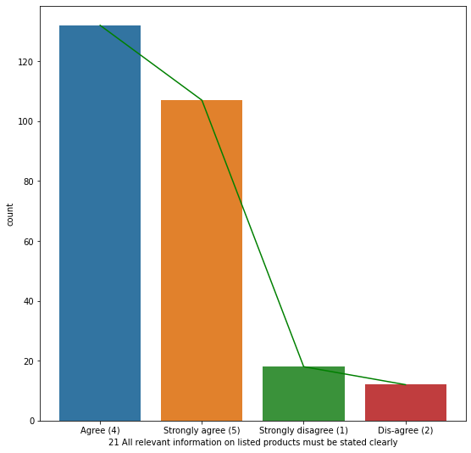
Various Plots for Category 2: Where Ratings are Involved

Slide 16
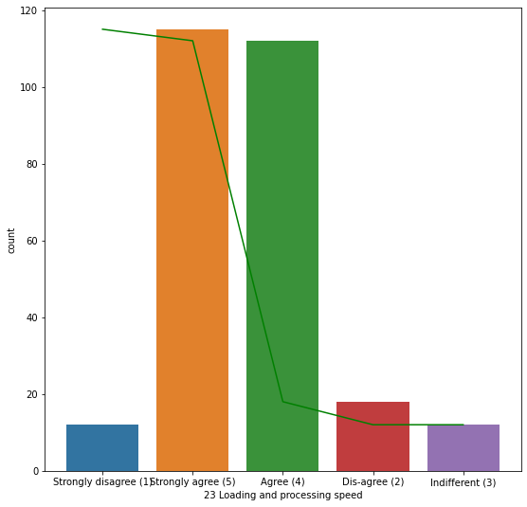
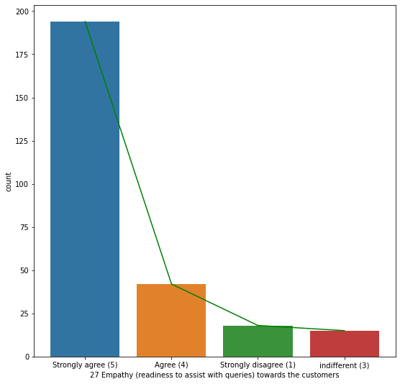

Slide 17
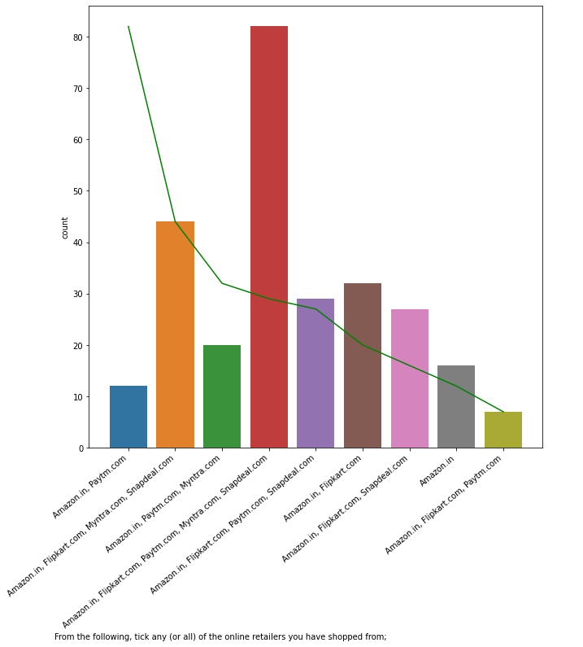
Various Plots for Category 3:Voting of Application/Website preference

Slide 18
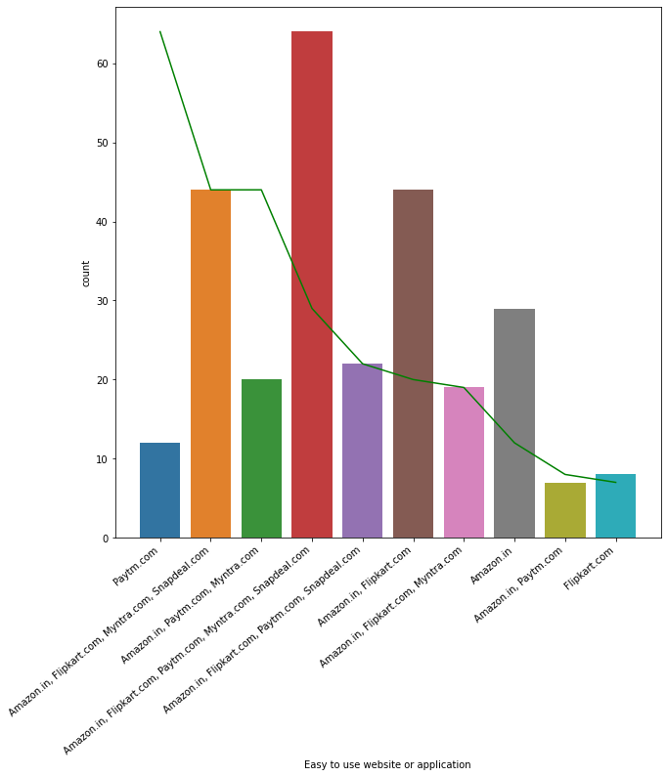

Slide 19
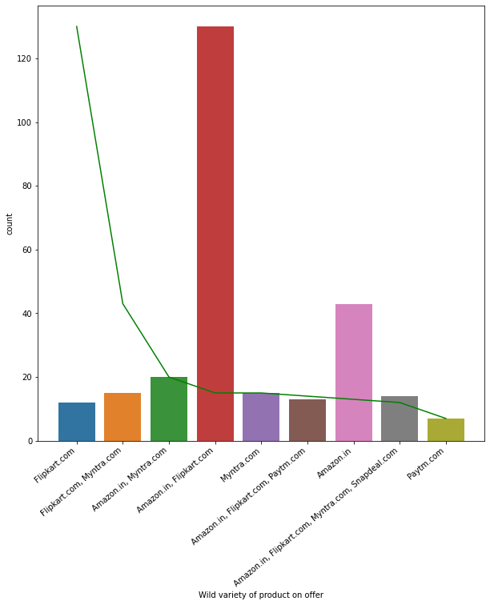

Slide 20
Data Visualization
Bivariate Analysis-The analysis was done based on :
Usage times of websites
Risk Assessment

Slide 21
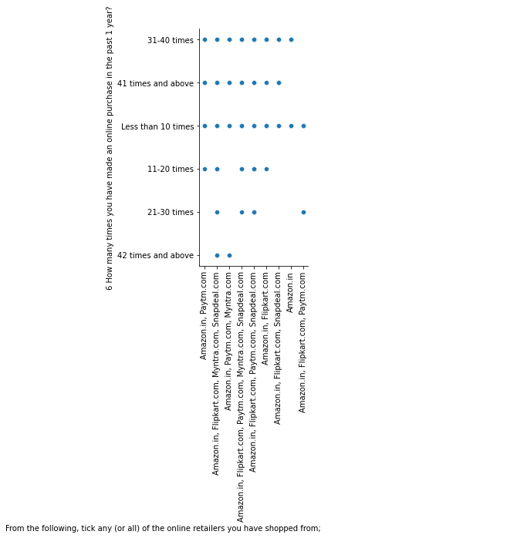
Various Plots for Category 1: Usage times of websites

Slide 22
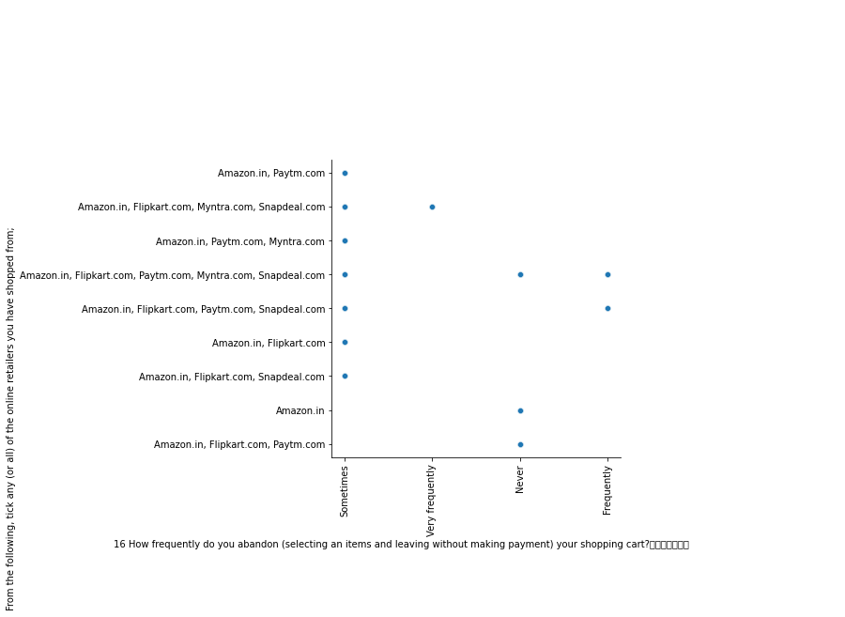

Slide 23
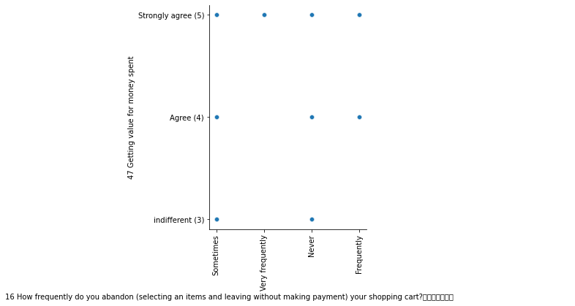
Various Plots for Category 2:Risk Assessment

Slide 24
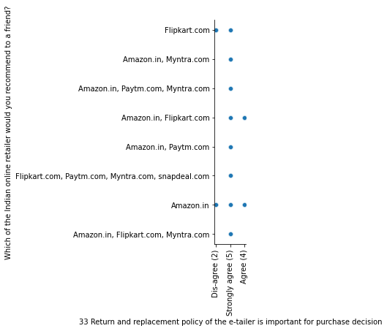

Slide 25
Consumer opinions on Website Features
Analyzing the opinions of the participants on the various features of the e-commerce websites reveals that Majority of the consumers strongly agree that:(Positive Features)
Easy to use website or application
Visual appealing web-page layout
Wild variety of product on offer
Complete, relevant description information of products
Fast loading website speed of website and application
Reliability of the website or application
Quickness to complete purchase
Availability of several payment options', 'Speedy order delivery
Privacy of customers’ information’
Security of customer financial information
Perceived Trustworthiness
Presence of online assistance through multi-channel

Slide 26
Analyzing the opinions of the participants on the various features of the e-commerce websites reveals that Majority of the consumers strongly disapprove of Negative Features)
Longer time to get logged in (promotion, sales period)
Late declaration of price (promotion, sales period)
Longer page loading time (promotion, sales period)
Limited mode of payment on most products (promotion, sales period)
Longer delivery period
Frequent disruption when moving from one page to another

Slide 27
For every website their positive as well as negative aspects were filtered based on the following factors:
We got to see Amazon was leading in the positive aspects as well as in some of the negative aspects, following the lead in positive aspects was flipkart , then myntra, paytm and last was snapdeal.
Below tables will give detailed info about positive and negative features of all the websites: Amazon, Flipkart, Myntra, Paytm, Snapdeal

Slide 28
Amazon
Positive Feedback | Negative Feedback
Easy to use website or application-249 Visual appealing web-page layout-227 Wild variety of product on offer-220 Complete, relevant description information of products-238 Fast loading website speed of website and application-249 Reliability of the website or application-227 Availability of several payment options-215 Speedy order delivery-240 Privacy of customers’ information-221 Security of customer financial information-206 Perceived Trustworthiness-227 Presence of online assistance through multi-channel-229 | Longer time to get logged in (promotion, sales period)-135 Longer time in displaying graphics and photos (promotion, sales period)-126 Late declaration of price (promotion, sales period)- 56 Longer page loading time (promotion, sales period)-68 Limited mode of payment on most products (promotion, sales period)-104 Frequent disruption when moving from one page to another-78

Slide 29
Flipkart
Positive Feedback | Negative Feedback
Easy to use website or application-201 Visual appealing web-page layout-175 Wild variety of product on offer-184 Complete, relevant description information of products-194 Fast loading website speed of website and application-162 Reliability of the website or application-146 Quickness to complete purchase-158 Availability of several payment options-203 Speedy order delivery-162 Privacy of customers’ information-150 Security of customer financial information-149 Perceived Trustworthiness-143 Presence of online assistance through multi-channel-136 | Longer time to get logged in (promotion, sales period)-103 Longer time in displaying graphics and photos (promotion, sales period)-94 Late declaration of price (promotion, sales period)- 43 Longer page loading time (promotion, sales period)-61 Limited mode of payment on most products (promotion, sales period)-60 Longer delivery period-44 Frequent disruption when moving from one page to another-62

Slide 30
Myntra
Positive Feedback | Negative Feedback
Easy to use website or application-147 Visual appealing web-page layout-115 Wild variety of product on offer-64 Complete, relevant description information of products-64 Fast loading website speed of website and application-74 Reliability of the website or application-64 Quickness to complete purchase-79 Availability of several payment options-132 Privacy of customers’ information-78 Security of customer financial information-99 Perceived Trustworthiness-88 Presence of online assistance through multi-channel-111 | Longer time in displaying graphics and photos (promotion, sales period)-74 Late declaration of price (promotion, sales period)- 75 Longer page loading time (promotion, sales period)-68 Frequent disruption when moving from one page to another-66

Slide 31
Paytm
Positive Feedback | Negative Feedback
Easy to use website or application-125 Visual appealing web-page layout-67 Complete, relevant description information of products-59 Fast loading website speed of website and application-99 Reliability of the website or application-96 Quickness to complete purchase-107 Privacy of customers’ information-68 Security of customer financial information-88 | Longer time to get logged in (promotion, sales period)-77 Late declaration of price (promotion, sales period)- 72 Longer page loading time (promotion, sales period)-94 Limited mode of payment on most products (promotion, sales period)-53 Longer delivery period-98 Frequent disruption when moving from one page to another-39

Slide 32
Snapdeal
Positive Feedback | Negative Feedback
Easy to use website or application-130 Visual appealing web-page layout-61 Complete, relevant description information of products-59 Fast loading website speed of website and application-81 Reliability of the website or application-45 Availability of several payment options-90 Speedy order delivery-50 Privacy of customers’ information-45 Security of customer financial information-100 Perceived Trustworthiness-74 | Easy to use website or application-130 Visual appealing web-page layout-61 Complete, relevant description information of products-59 Fast loading website speed of website and application-81 Reliability of the website or application-45 Availability of several payment options-90 Speedy order delivery-50 Privacy of customers’ information-45 Security of customer financial information-100 Perceived Trustworthiness-74

Slide 33
CONCLUSION AND FUTURE SCOPE
Most customers abandon their shopping carts on Amazon and flipkart because of change in price or when they find a better deal elsewhere, whereas on paytm,myntra snapdeal etc, the reasons are varied but largely are due to lack of trust or absence of preferred mode of payment.
Since the cost of getting a new customer is an estimated five to ten times more than keeping an old one, nurturing loyal customers is a powerful strategy that helps businesses grow. And all these feedbacks will help in Customer Retention if company adopts them properly.

Slide 34
Thank You

